Slide 1
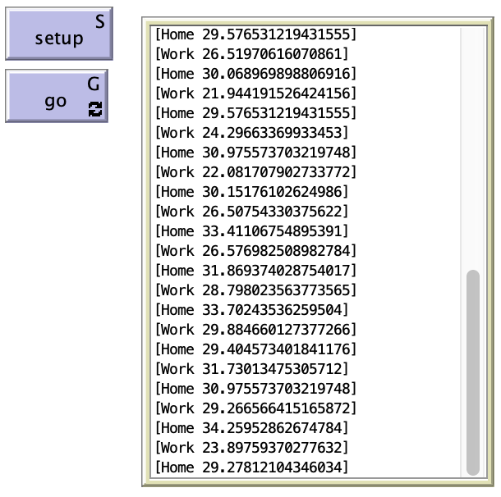
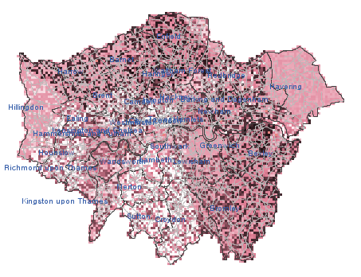
A
B

Slide 2
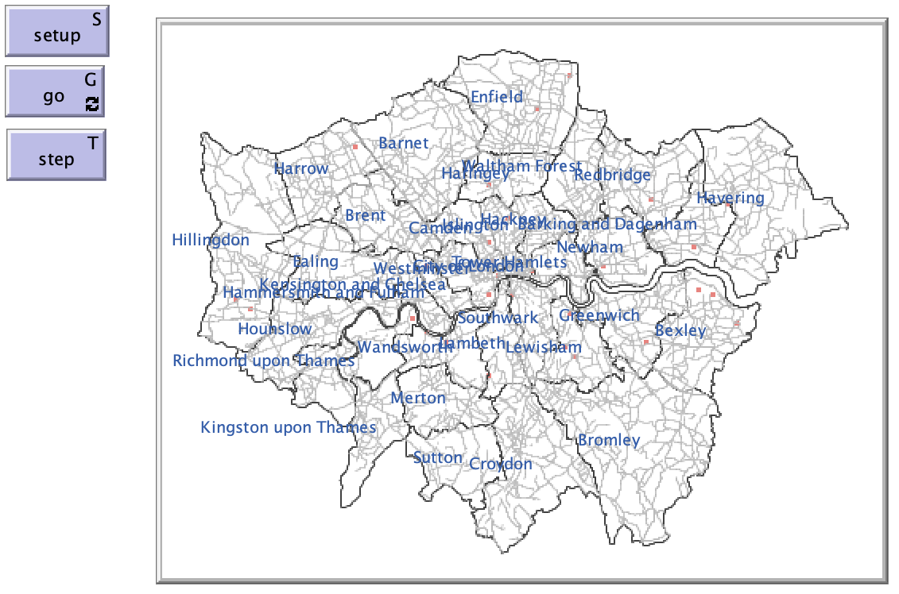
A
B

Slide 3
Step 1:
Identify Missing Data
Step 2:
Impute Missing Data using Seasonal Moving Average (SMA)
Step 3:
Generate NO₂ data from the nearest background station
Step 4:
Add Road Weighting on Road Grids
Step 5:
Validate Modelled Road NO₂ with existing data

